Slide 1


CCNP SWITCH v7.1
Chapter 10: Campus Network Security

Slide 2
Focus on topics
Overview of switch security issues
Required best practices for basic security protection on Catalyst switches
Campus network vulnerabilities
Port security
Storm control
Mitigating spoofing attacks
DHCP snooping, IP Source Guard, and dynamic ARP inspection
Securing VLAN trunks
Private VLANs
2

Slide 3

Overview of Switch Security Issues
Notes:
High availability is not just about adding redundant devices. It implies planning to understand where the points of failure occur and designing the network so that an alternative solution exists to compensate for the loss of these points of failure.
This chapters provides an overview on how to implement a high-availability solution according to a given network design and requirements. This includes building a resilient network with optimal redundancy for high availability. Monitoring the network using SNMP, Syslog, and IP SLA are key elements to ensure the high availability of the network.
This chapter also covers supervisor redundancy options such as RPR, RPR+, SSO, and NSF.
For ensuring first hop gateway redundancy, the Hot Standby Router Protocol (HSRP), Virtual Router Redundancy Protocol (VRRP) and Gateway Load Balancing Protocol (GLBP) are needed. First hop redundancy protocols (FHRP) allow for nondisruptive failover between available redundant gateways. HSRP/VRRP allow for one primary router per subnet with other routers acting as standby/backup. GLBP allows load balancing across multiple gateways for the same subnet.
High availability is technology that enables networkwide resilience to increase IP network availability. Network applications must cross different network segments—from the Enterprise Backbone, Enterprise Edge, and Service Provider Edge, through the Service Provider Core. All segments must be resilient to recover quickly enough for faults to be transparent to users and network applications. This chapter describes the high availability concept, how resiliency is built, and how the network is designed to always offer a path between any pair of end points.

Slide 4
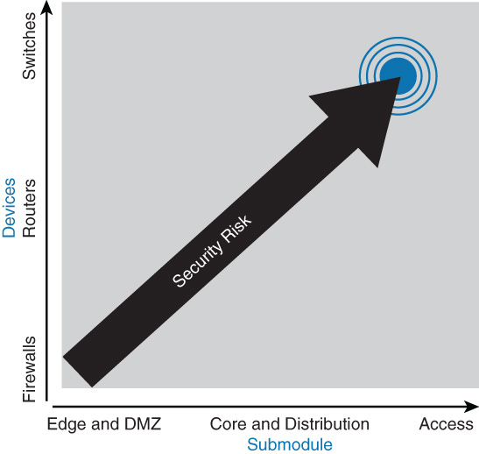
The need for Switch Security
Most of the industry attention focuses on security attacks from outside the walls of an organization and at the upper OSI layers.
Network security often focuses on edge routing devices and the filtering of packets that are based on Layer 3 and Layer 4 headers, ports, stateful packet inspection, and so on.
Most of this filtering occurs on high-end firewalls such as the Cisco Adaptive Security Appliance (ASA).
Campus access devices and Layer 2 communication are largely unconsidered or an afterthought in most security discussions, which potentially leaves the campus network vulnerable to internal attacks.

Slide 5
The need for Switch Security
In review of switch security issues, several reasons exist for strong protection of the enterprise campus infrastructure, including security functions in each individual element of the enterprise campus network. :
Relying on the security that has been established at the enterprise edge fails as soon as security there is compromised.
Having several layers of security increases the protection of the enterprise campus, where the most strategic assets usually reside.
If the enterprise allows visitors into its buildings, an attacker can potentially gain physical access to devices in the enterprise campus.
Relying on physical security is not enough.
External access does not stop at the enterprise edge. Applications require at least an indirect access to the enterprise campus resources, which means that strong campus network security is also necessary.
Public and hybrid cloud architectures pose new risks.
Even if the cloud is secure, attacks from the inside can ultimately compromise the cloud.

Slide 6

Cisco Switch Security Configuration Best Practices

Slide 7
Cisco Switch Security Configuration Best Practices
From a Cisco switch configuration perspective, there is a minimal set of required configurations necessary to provide basic security.
Secure passwords.
Leverage system banners.
Secure console access.
Secure vty lines.
Secure the embedded web interface.
Always leverage SSH and ensure that the Telnet server is disabled
Secure SNMP access
Secure STP operation
Secure CDP
Secure SNMP.
Secure unused switch ports.
Notes:
Implementation of a basic security configuration on every installed Cisco device is a requirement for preventing network vulnerabilities.
Cisco recommends the security measures above on every Cisco device in your network to aid in network-security protection.
The techniques listed here are simple and easy to understand for those interested in implementing a minimum level of security on Cisco switches. This list is not a complete list, and you should review additional product security configurations per platform. Furthermore, these security principles are applicable to other Cisco products, including routers, SAN switches, and network appliances.

Slide 8
Secure Passwords
The enable password command employs weak encryption. Use enable secret whenever possible. (should now use the enable algorithm-type scrypt secret password command)
Use the service password-encryption global configuration command to encrypt all passwords cannot be encrypted using strong authentication.
Even though this is weak, easily broken encryption, it can prevent casual passer-by from seeing the clear-text passwords.
Having external AAA (authentication, authorization, and accounting) servers means that you do not need to manage and maintain user credentials on individual devices.
Use of external AAA authentication is requirement of any large enterprise

Slide 9
System Warning Banners
For both legal and administrative purposes, configuring a system warning banner to display prior to login is a convenient and effective way of reinforcing security and general usage policies.
Clearly stating the ownership, usage, access, and protection policies prior to a login aids in stronger prosecution if unauthorized access occurs.
Use the global configuration banner command to configure system banner messages.
Use the banner login command to configure text that is displayed to authenticated users.
MOTD banner: the “message of the day” banner is presented to everyone that connects to the router.
Login banner: this one is displayed just before the authentication prompt.
Exec banner: displayed before the user sees the exec prompt.
Incoming banner: used for users that connect through reverse telnet.
Notes:
For more information about configuring banners, refer to the following URL:
www.cisco.com/en/US/docs/ios/fundamentals/configuration/guide/cf_connections_ps6350_TSD_Products_Configuration_Guide_Chapter.html.

Slide 10
Secure Physical Access to the Console
Physical security of switches or routers is often overlooked but is a valuable security precaution.
Console access requires a minimum level of security both physically and logically.
An individual who gains console access to a system gains the ability to recover or reset the passwords or to reload the system, thereby enabling that individual to bypass all other security measures implemented on that system.
It is imperative to physically secure access to the console by using security personnel, closed circuit television, card-key entry systems, locking cabinets, access logging, or other means to control physical access as standard practice.

Slide 11
Secure Access to vty Lines
Apply ACLs on all vty lines to limit in-band access only to management stations from specific subnets.
Configure strong passwords for all configured vty lines.
Use Secure Shell (SSH) instead of Telnet to access the device remotely.
Example configuration:
acccess-list 1 permit 10.0.0.234
acccess-list 1 permit 10.0.0.235
line vty 0 15
access-class 1 in

Slide 12
Secure the Embedded Web Interface
If you are not using the web interface to manage a switch, disable its web interface using the no ip http server command.
If you decide to use the switch’s web interface, use HTTPS. With standard HTTP, the traffic is not encrypted. To enable HTTPS, use the ip http secure-server command.
If you decide to use the switch’s web interface, use access lists to limit source addresses that can access the HTTPS interface.
Example configuration:
no ip http server
ip http secure server
access-list 1 permit 10.100.50.0 0.0.0.255
ip http access-class 1
HTTP is disabled by default on later IOS versions
Notes:
Although Cisco IOS provides an integrated HTTP server for ease of management, the recommendation is to disable this feature, especially in multilayer switched networks that do not use this method for management. Otherwise, any unauthorized user might gain access via the web interface and make configuration changes. A user might also send numerous HTTP requests to the switch or router, which might cause high CPU utilization, resulting in a DoS-type attack on the system. In Cisco IOS, the integrated HTTP server is disabled by default. If HTTP access is necessary, use a different HTTP port, and use ACLs to isolate access from only trusted subnets or workstations.

Slide 13
Use SSH not Telnet
Telnet is easy to use but not secure. All text that is sent through a Telnet session is passing clear text.
It is easy to eavesdrop on telnet sessions and observe usernames and passwords with a simple sniffer.
SSH uses strong encryption to secure session data.
You should use the highest SSH version available on the device.

Slide 14
Securing SNMP
If you do not need the write access through SNMP, disable it.
This will prevent unauthorized users from making changes to the configuration.
It is always recommended to exclusively use SNMPv3, which leverages secure authentication.
Notes:
SNMP is covered in more detail in Chapter 5.
For additional information on how to secure SNMP, refer to the following document on Cisco.com: “Securing Simple Network Management Protocol,” Document ID: 20370, www.cisco.com/en/US/tech/tk648/tk362/technologies_tech_note09186a0080094489.shtml.

Slide 15
Secure STP Operation
You should always enable BPDU Guard feature on any access switch ports.
This way, if an unexpected BPDU is received, the port will be automatically disabled.
Do not ever configure BPDU Guard and BPDU Filter on the same port. If you do, only BPDU Filter will take effect.
BPDU Filter ignores BPDUs when enabled on interface; and if you enable it on access ports, this can be a great opportunity for a layer 2 loop to occur.

Slide 16
Trimming and Minimizing Use of CDP/LLDP
Disable CDP/LLDP on a per-interface basis. Run CDP/LLDP only for administrative purposes, such as on inter-switch connections and interfaces where IP phones reside.
Confine CDP/LLDP deployment to run between devices under your control.
Because CDP/LLDP is a link-level (Layer 2) protocol, it does not propagate end-to-end over a MAN or WAN unless a Layer 2 tunneling mechanism is in place.
As a result, for MAN and WAN connections, CDP tables might include the service provider’s next-hop router or switch and not the far-end router under your control.
Do not run CDP/LLDP to any unsecured connection, such as Internet connections.
Notes:
Security with CDP/LLDP remains fairly controversial. Although CDP/LLDP propagates detailed information about respective network devices, correct planning and configuration of CDP/LLDP enables it to be a fairly safe protocol. This is a great advantage because auxiliary VLANs and specific solutions in many multilayer switched networks require CDP/LLDP.
For a practical and secure deployment of CDP/LLDP, adhere to the CDP/LLDP configuration guidelines listed above.

Slide 17
Secure Unused Switch Ports
All unused switch ports should be shut down to prevent unauthorized users from connecting to your network.
All user ports should be configured with switchport mode access command.
If user ports are configured to Dynamic Trunking Protocol’s (DTP) dynamic or auto mode, a malicious user might connect and attempt to negotiate trunking mode on a port.
For ports that remain enabled, alternatively place all other unused ports into an isolated or bogus VLAN.
If malicious users succeed in accessing an unused port, they will only have access to a VLAN that is isolated and will prevented from accessing and rest of the network.
Notes:
Refer to Chapter 2 for more information on how to disable automatic negotiation of trunking and other VLAN configurations such as VTP.

Slide 18
Campus Network Vulnerabilities
Notes:
Network security vulnerabilities include loss of privacy, data theft, impersonation, and loss of integrity. Basic security measures should be taken on every network to mitigate adverse effects of user negligence or acts of malicious intent. Best practices following these general steps are required whenever placing new equipment in service.
Step 1. Consider or establish organizational security policies.
Step 2. Secure switch device and protocols.
Step 3. Mitigate compromises launched through a switch.

Slide 19
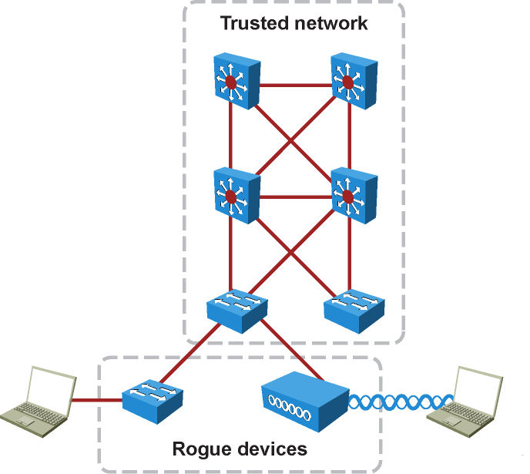
Unauthorized Access by Rogue Devices
Aside from the common vulnerabilities with networks in general, the campus network has specific vulnerabilities that warrant additional scrutiny.
The most common vulnerability in the campus network is unauthorized rogue access.
Access Points
Switches
Servers
Notes:
Rogue access comes in several forms, as shown in the figure. For example, because unauthorized rogue access points are inexpensive and readily available, employees sometimes plug them into existing LANs and build ad hoc wireless networks without IT department knowledge or consent. These rogue access points can be a serious breach of network security because they can be plugged into a network port behind the corporate firewall. Because employees generally do not enable any security settings on the rogue access point, it is easy for unauthorized users to use the access point to intercept network traffic and hijack client sessions.
Malicious rogue access points, although much less common than employee-installed rogue access points, are also a security concern. These rogue access points create an unsecured wireless LAN connection that puts the entire wired network at risk. Malicious rogues present an even greater risk and challenge because they are intentionally hidden from physical and network view by not broadcasting the SSID.
To mitigate Spanning Tree Protocol (STP) manipulation, use the root guard and the BPDU guard enhancement commands to enforce the placement of the root bridge in the network and to enforce the STP domain borders. The root guard feature is designed to provide a way to enforce the root bridge placement in the network. The STP bridge protocol data unit (BPDU) guard is designed to enable network designers to keep the active network topology predictable. Although the BPDU guard might seem unnecessary, given that the administrator can set the bridge priority to zero, there is still no guarantee that it will be elected as the root bridge because there might be a bridge with priority zero and a lower bridge ID. A BPDU guard is best deployed toward user-facing ports to prevent unauthorized switches from being attached to the network by an attacker.

Slide 20
Switch Vulnerabilities
After rogue access has been achieved, attacks may be generated in an effort to disrupt the network.
The attack may also come from an external intrusion that takes control of, and launches attacks from, a trusted device.
In either case, the network sees all traffic as originating from a legitimate connected device.
Attacks that are launched against switches and at Layer 2 can be grouped as follows:
MAC layer attacks
VLAN attacks
Spoofing attacks
Attacks on switch devices

Slide 21
Layer 2 Attack Categories (1)
Attack Method | Description | Steps to Mitigation
MAC Layer Attacks
MAC Address Flooding | Frames with unique, invalid source MAC addresses flood the switch, exhausting content addressable memory (CAM) table space, disallowing new entries from valid hosts. Traffic to valid hosts is subsequently flooded out all ports. | Port security. MAC address VLAN access maps.
VLAN Attacks
VLAN Hopping | By altering the VLAN ID on packets encapsulated for trunking, an attacking device can send or receive packets on various VLANs, bypassing Layer 3 security measures. | Tighten up trunk configurations and the negotiation state of unused ports. Place unused ports in a common VLAN.
Attacks between Devices on a Common VLAN | Devices might need protection from one another, even though they are on a common VLAN. This is especially true on service-provider segments that support devices from multiple customers. | Implement private VLANs (PVLAN).
Notes:
Layer 2 malicious attacks are typically initiated by devices directly connected to the campus network infrastructure. The attacks can originate from a physical rogue device placed on the network for malicious purposes. The attack also can come from an external intrusion that takes control of and launches attacks from a trusted device. In either case, the network sees all traffic as originating from a legitimate connected device.
Attacks launched against switches and at Layer 2 can be grouped as follows:
MAC layer attacks
VLAN attacks
Spoofing attacks
Attacks on switch devices
These attack methods and steps to mitigate these threats are discussed in more detail in this chapter.
The table spanning this slide and the next two slides describes attack methods and the steps to mitigation.

Slide 22
Layer 2 Attack Categories (2)
Attack Method | Description | Steps to Mitigation
Spoofing Attacks
DHCP Starvation and DHCP Spoofing | An attacking device can exhaust the address space available to the DHCP servers for a period of time or establish itself as a DHCP server in man-in-the- middle attacks. | Use DHCP snooping.
Spanning-tree Compromises | Attacking device spoofs the root bridge in the STP topology. If successful, the network attacker can see a variety of frames. | Proactively configure the primary and backup root devices. Enable root guard.
MAC Spoofing | Attacking device spoofs the MAC address of a valid host currently in the CAM table. The switch then forwards frames destined for the valid host to the attacking device. | Use DHCP snooping Port security.
Address Resolution Protocol (ARP) Spoofing | Attacking device crafts ARP replies intended for valid hosts. The attacking device’s MAC address then becomes the destination address found in the Layer 2 frames sent by the valid network device. | Use Dynamic ARP Inspection (DAI), DHCP snooping, port security.

Slide 23
Layer 2 Attack Categories (3)
Attack Method | Description | Steps to Mitigation
Switch Device Attacks
Cisco Discovery Protocol (CDP) Manipulation | Information sent through CDP is transmitted in clear text and unauthenticated, allowing it to be captured and divulge network topology information. | Disable CDP on all ports where it is not intentionally used.
Secure Shell Protocol (SSH) and Telnet Attacks | Telnet packets can be read in clear text. SSH is an option but has security issues in version 1. | Use SSH version 2. Use Telnet with vty ACLs.

Slide 24
Understanding and Protecting against MAC Layer Attacks
Notes:
A common Layer 2 or switch attack is MAC flooding, resulting in a switch’s CAM table overflow, which causes flooding of regular data frames out all switch ports. This attack can be launched for the malicious purpose of collecting a broad sample of traffic or as a denial of service (DoS) attack.
A switch’s CAM tables are limited in size and therefore can contain only a limited number of entries at any one time. A network intruder can maliciously flood a switch with a large number of frames from a range of invalid source MAC addresses. If enough new entries are made before old ones expire, new valid entries will not be accepted. Then, when traffic arrives at the switch for a legitimate device located on one of the switch ports that could not create a CAM table entry, the switch must flood frames to that address out all ports. This has two adverse effects:
The switch traffic forwarding is inefficient and voluminous and could potentially slow down the network for all users.
An intruding device can be connected to any switch port and capture traffic not normally seen on that port.
If the attack is launched before the beginning of the day, the MAC address table (also referred to as Content Addressable Memory [CAM] table) would be full when the majority of devices are powered on. Then frames from those legitimate devices cannot create MAC address table entries as they power on. If this represents a large number of network devices, the number of MAC addresses flooded with traffic will be high, and any switch port will carry flooded frames from a large number of devices.
If the initial flood of invalid MAC address table entries is a one-time event, the switch eventually ages out older, invalid MAC address table entries, allowing new, legitimate devices to create entries. Traffic flooding ceases and might never be detected, even though the intruder might have captured a significant amount of data from the network.

Slide 25
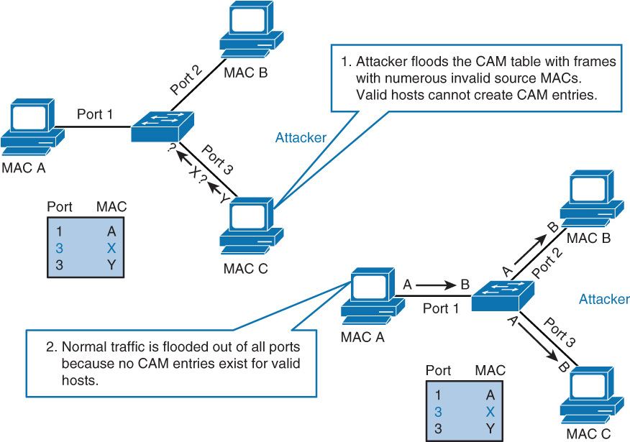
Understanding MAC Layer Attacks
A common Layer 2 or switch attack is MAC flooding, which results in an overflow of the CAM table of a switch.
The overflow causes the flooding of regular data frames out all switch ports, black-holing, or intermittent loss of traffic.
This attack can be launched for the malicious purpose of collecting a broad sample of traffic or as a denial-of-service (DoS) attack where the switch does not function correctly
This scenario has the following two possible adverse effects:
The switch traffic forwarding is inefficient and voluminous.
An intruding device can be connected to any switch port and can capture traffic that is not normally detected on that port.
Notes:
As the figure illustrates, MAC flooding occurs in a certain progression.

Slide 26
Understanding MAC Layer Attacks
Step 1. Switch forwards traffic based on valid MAC address table entries.
Step 2. Attacker (MAC address C) sends out multiple packets with various source MAC addresses.
Step 3. Over a short time period, the CAM table in the switch fills up until it cannot accept new entries. As long as the attack is running, the MAC address table on the switch remains full.
Step 4. Switch begins to flood all packets that it receives out of every port so that frames sent from Host A to Host B are also flooded out of Port 3 on the switch.
Notes:
As the figure illustrates, MAC flooding occurs in a certain progression.

Slide 27
Protecting against MAC Layer Attacks
To prevent MAC Address flooding, port security can be used.
Configure port security to define the number of MAC addresses allowed on a given port.
Port security can also specify what MAC address is allowed on a given port.

Slide 28
Port Security
Cisco-proprietary feature on Catalyst switches.
Restricts switch port to specific set or number of MAC addresses, which can be learned dynamically or configured statically.
The port then will only give access to frames from only those addresses.
“Sticky learning” combines dynamically learned and statically configured addresses.
Dynamically learned addresses are converted to sticky secure addresses, as if they were configured using the switchport port-security mac-address interface command.
Notes:
Port security is a feature supported on Cisco Catalyst switches that restricts a switch port to a specific set or number of MAC addresses. Those addresses can be learned dynamically or configured statically. The port then provides access to frames from only those addresses. If, however, the number of addresses is limited to four but no specific MAC addresses are configured, the port enables any four MAC addresses to be learned dynamically, and port access is limited to those four dynamically learned addresses.
A port security feature called sticky learning, available on some switch platforms, combines the features of dynamically learned and statically configured addresses. When this feature is configured on an interface, the interface converts dynamically learned addresses to sticky secure addresses. This adds them to the running configuration as if they were configured using the switchport port-security mac-address interface command.

Slide 29
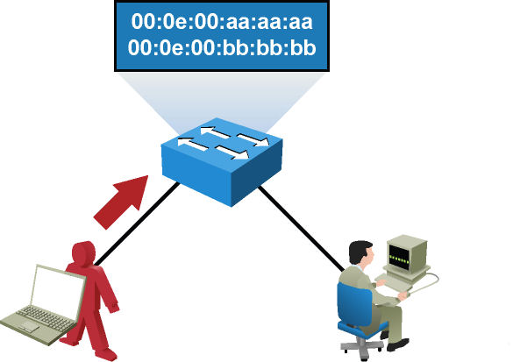
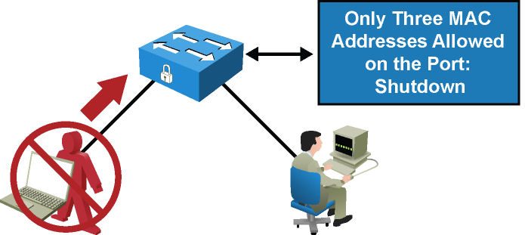
Port Security
An attacker enables a hacking tool on the attacker’s rogue device to flood switch CAM tables with bogus MAC addresses, causing the MAC address table to fill up. When the MAC address table is full, it turns the switch into a hub and floods all unicast frames.
Port security is configured on untrusted user ports. Enabling port security limits MAC flooding attacks and locks down the port.
Port security also sets an SNMP trap alerting of any violation. Port security allows the frames from already secured MAC address below the maximum number of MAC addresses enabled on that port, and any frame with a new MAC address over the limit is dropped.

Slide 30
Port Security Process
Step | Action | Notes
1 | Configure port security. | Configure port security to allow only five connections on that port. Configure an entry for each of the five allowed MAC addresses. This, in effect, populates the MAC address table with five entries for that port and allows no additional entries to be learned dynamically.
2 | Allowed frames are processed. | When frames arrive on the switch port, their source MAC address is checked against the MAC address table. If the frame source MAC address matches an entry in the table for that port, the frames are forwarded to the switch to be processed like any other frames on the switch.
3 | New addresses are not allowed to create new MAC address table entries. | When frames with a non-allowed MAC address arrive on the port, the switch determines that the address is not in the current MAC address table and does not create a dynamic entry for that new MAC address because the number of allowed addresses has been limited.
4 | Switch takes action in response to non-allowed frames. | The switch disallows access to the port and takes one of these configuration-dependent actions: (a) the entire switch port can be shut down (shutdown); (b) access can be denied for that MAC address only and a log error can be generated (restrict); (c) access can be denied for that MAC address but without generating a log message (protect).

Slide 31
Configuring Port Security
Step 1. Enable port security:
Switch(config-if)# switchport port-security
Step 2. Set a maximum number of MAC addresses that will be allowed on this port. The default is one:
Switch(config-if)#switchport port-security maximum value
Step 3. Specify which MAC addresses will be allowed on this port (optional):
Switch(config-if)#switchport port-security mac-address mac-address
Step 4. Convert all dynamic port security-learned MAC addresses to sticky secure MAC addresses (optional):
Switch(config-if)#switchport port-security mac-address sticky
Step 5. Define what action an interface will take if a non-allowed MAC address attempts access:
Switch(config-if)#switchport port-security violation {shutdown | restrict | protect}
Notes:
Here are the steps to set up port security to limit switch port access to a finite number and a specific set of end-station MAC addresses.
Step 1. Port security is enabled on a port-by-port basis using the switchport port security command.
Step 2. By default, only one MAC address is allowed access through a given switch port when port security is enabled. This parameter increases that number. It implies no restriction on specific MAC addresses, just on the total number of addresses that can be learned by the port. Learned addresses are not aged out by default but can be configured to do so after a specified time using the switchport port-security aging command. The value parameter can be any number from 1 to 1024, with some restrictions having to do with the number of ports on a given switch with port security enabled. The switchport port security aging static command enables aging for statically configured secure addresses on the port.
Step 3. Access to the switch port can be restricted to one or more specific MAC addresses. If the number of specific MAC addresses assigned using this command is lower than the value parameter set in Step 2, the remaining allowed addresses can be learned dynamically. If you specify a set of MAC addresses that is equal to the maximum number allowed, access is limited to that set of MAC addresses.
Step 4. By default, if the maximum number of connections is achieved and a new MAC address attempts to access the port, the switch must take one of these actions:
Protect: Frames from the non-allowed address are dropped, but there is no log of the violation.
Restrict: Frames from the non-allowed address are dropped, a log message is created, and a Simple Network Management Protocol (SNMP) trap is sent.
Shutdown: If any frames are seen from a non-allowed address, the interface is errdisabled, a log entry is made, an SNMP trap is sent, and manual intervention or errdisable recovery must be used to make the interface usable. Shutdown mode is the default mode for violation.

Slide 32
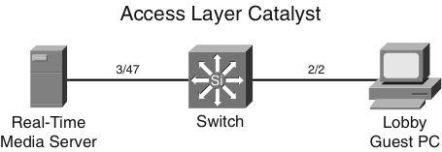
Port Security Example
4503(config)# interface FastEthernet 3/47
4503(config-if)# switchport
4503(config-if)# switchport mode access
4503(config-if)# switchport port-security
4503(config-if)# switchport port-security mac-address 0000.0000.0008
4503(config-if)# switchport port-security maximum 1
4503(config-if)# switchport port-security aging time 2
4503(config-if)# switchport port-security aging static
4503(config-if)# switchport port-security violation restrict
4503(config)# interface FastEthernet 2/2
4503(config-if)# switchport
4503(config-if)# switchport mode access
4503(config-if)# switchport port-security
4503(config-if)# switchport port-security mac-address 0000.0000.1118
4503(config-if)# switchport port-security maximum 1
4503(config-if)# switchport port-security aging time 2
4503(config-if)# switchport port-security aging static
4503(config-if)# switchport port-security violation shutdown
Notes:
The figure depicts an access layer Catalyst 4500 switch scenario. A real-time media server plugs in to switch port 3/47. The switch port needs port security to prevent any unauthorized devices from plugging into the same port. The administrator has configured preferential QoS policies based on all traffic received on the port and other security ACLs. The network administrator requirement is not to shut down the port of the server but rather to restrict the port to only the authorized MAC address. In addition, the network administrator configures the switch to shut down port 2/2 in the guest lobby if any unauthorized workstation plugs into that port.
The command switchport port-security aging static enables aging for the statically configured secure address on the port. This configuration sets the absolute aging time as 2 minutes for the static secure address.
The port security aging feature is disabled by default. The default aging time is 0 minutes. All the secure addresses on this port age out exactly after the time specified and are removed from the secure address list.

Slide 33
Verifying Port Security
The show port-security command can be used to verify the ports on which port security has been enabled. It also displays count information and security actions to be taken per interface.
switch# show port-security
Secure Port MaxSecureAddr CurrentAddr SecurityViolation Security Action
(Count) (Count) (Count)
------------------------------------------------------------------------
Fa0/1 2 1 0 Restrict
------------------------------------------------------------------------
Total Addresses in System (excluding one mac per port) : 0
Max Addresses limit in System (excluding one mac per port) : 6144

Slide 34
Verifying Port Security
switch# show port-security interface fastethernet0/1
Port Security : Enabled
Port Status : Secure-up
Violation Mode : Restrict
Aging Time : 60 mins
Aging Type : Inactivity
SecureStatic Address Aging : Enabled
Maximum MAC Addresses : 2
Total MAC Addresses : 1
Configured MAC Addresses : 0
Sticky MAC Addresses : 0
Last Source Address:Vlan : 001b.d513.2ad2:5
Security Violation Count : 0
switch# show port-security address
Secure Mac Address Table
------------------------------------------------------------------------
Vlan Mac Address Type Ports Remaining Age
(mins)
---- ----------- ---- ----- -------------
2 001b.d513.2ad2 SecureDynamic Fa0/1 60 (I)
------------------------------------------------------------------------
Total Addresses in System (excluding one mac per port) : 0
Max Addresses limit in System (excluding one mac per port) : 6144
Notes:
Arguments are provided to view port security status by interface or view the addresses associated with port security on all interfaces.
Use the interface argument to provide output for a specific interface.
Use the address argument to display MAC address table security information. The remaining age column is populated only when specifically configured for a given interface.

Slide 35
Configuring Port Security with Sticky MAC Addresses
switch# show running-config fastethernet 0/1
interface FastEthernet0/1
switchport access vlan 2
switchport mode access
switchport port-security maximum 2
switchport port-security
switchport port-security violation restrict
switchport port-security mac-address sticky
switchport port-security mac-address sticky 001b.d513.2ad2
switch# show port-security address
Secure Mac Address Table
------------------------------------------------------------------------
Vlan Mac Address Type Ports Remaining Age
(mins)
---- ----------- ---- ----- -------------
2 001b.d513.2ad2 SecureSticky Fa0/1 -
Notes:
Port security can mitigate spoofing attacks by limiting access through each switch port to a single MAC address. This prevents intruders from using multiple MAC addresses over a short time period but does not limit port access to a specific MAC address. The most restrictive port security implementation would specify the exact MAC address of the single device that is to gain access through each port. Implementing this level of security, however, requires considerable administrative overhead.
Port security has a sticky MAC addresses feature that can limit switch port access to a single, specific MAC address without the network administrator having to gather the MAC address of every legitimate device and manually associate it with a particular switch port.
When sticky MAC addresses are used, the switch port converts dynamically learned MAC addresses to sticky MAC addresses and subsequently adds them to the running configuration as if they were static entries for a single MAC address to be allowed by port security. Sticky secure MAC addresses will be added to the running configuration but will not become part of the startup configuration file unless the running configuration is copied to the startup configuration after addresses have been learned. If they are saved in the startup configuration, they will not have to be relearned upon switch reboot, and this provides a higher level of network security.
Note: The interface converts all the dynamic secure MAC addresses, including those that were dynamically learned before sticky learning was enabled, to sticky secure MAC addresses.
The interface level configuration command that follows converts all dynamic port security learned MAC addresses to sticky secure MAC addresses: switchport port-security mac-address sticky
This command cannot be used on ports where voice VLANs are configured.
The example above shows the configuration and verification of the sticky MAC address feature of port security.
Note: The number of combinations and permutations related to port security are fairly mind boggling. It is one of those technologies that you just need to know what it basically is and how it basically works; but for non-trivial applications, just rely on cisco.com for details in each case:
http://www.cisco.com/en/US/docs/switches/lan/catalyst3560/software/release/12.2_55_se/configuration/guide/swtrafc.html#wp1038501 and
http://www.cisco.com/en/US/docs/switches/lan/catalyst3560/software/release/12.2_55_se/command/reference/cli3.html#wp1948361
In the example above, the obvious question you should ask yourself is “Was the line ‘switchport port-security mac-address sticky 001b.d513.2ad2’ typed in or did it appear automatically as a result of the switch discovering the device off F0/1 with the MAC address displayed and after entering the command ‘switchport port-security mac-address sticky’”?

Slide 36
Port Error Conditions
The switch places a port into an err-disabled state and shuts down the interface when it detects error conditions or takes action based on specific effect. Examples include port security violations, duplex mismatches, and excessive link flapping.
Ideally, this behavior of error-disabling a port is a best practice because a malfunctioning port or a major misconfiguration of spanning tree could cause a major network outage.
The following list highlights the most common situations where a port will go into the err-disabled state:
Port security violation
Spanning-tree BPDU guard violation
EtherChannel misconfiguration
Duplex mismatch
UDLD condition
Spanning-tree Root Guard
Link flapping
Other reasons: Other reasons include late collision detection, Layer 2 Tunneling Protocol Guard, DHCP snooping rate-limit, incorrect gigabit interface convert (GBIC), and ARP inspection.

Slide 37
Err-Disabled Automatic Recovery
Once the root cause of the err-disabled state is removed, an err-disabled port can become operational after a shut/no shut.
Because the error condition is no longer present, the trigger for err-disable will not occur.
Therefore, to reduce the administrative overhead, the switch port can be configured to be automatically reenabled after a specified time.
Of course, if the error condition is still present, the port will immediately go back to the err-disabled state.
Switch(config)# errdisable recovery cause psecure-violation Switch(config)# errdisable recovery interval 60
The default time interval for err-disable autorecovery is 300 seconds, and the minimum is 30 seconds.
You can verify where you have autorecovery enabled by using the command show errdisable recovery.
By default, the autorecovery feature is disabled.

Slide 38
Port Access Lists
Port access lists (PACLs) are yet another way to apply security in the campus network.
Standard access control lists (ACLs) are applied to traffic passing through the Layer 3 interface (for instance, a switch virtual interface [SVI] used to route from one VLAN to another VLAN on a Layer 3 switch).
The PACL feature provides the ability to perform access control on a specific Layer 2 port.
A Layer 2 port is a physical access or trunk port that belongs to a VLAN.
The port ACL feature is supported only in hardware. (Port ACLs are not applied to any packets routed in software.)
The PACL feature does not affect Layer 2 control packets, such as CDP, VTP, DTP, and STP, received on the port.
There are two types of PACL:
IP access list filters IPv4 and IPv6 packets on a Layer 2 port.
MAC access list filters packets that are of an unsupported type (not IP, ARP, or MPLS) based on the fields of the Ethernet frame. A MAC access list is not applied to IP, MPLS, or ARP messages. You can define only named MAC access lists.

Slide 39
Port Access Lists
PACLs interaction with other types of ACLs depends on the configured mode:
In prefer port mode, the PACL takes effect and overrides the effect of other ACLs. This mode is the only mode that is allowed when applying PACL on a trunk.
In merge mode, PACLs, VACLs, and standard ACLs are merged in the ingress direction. This is the default mode.
PACLs can be configured on an EtherChannel interface, but not on its port members.
IP and MAC ACLs can be applied to Layer 2 physical interfaces.
Standard (numbered, named) and extended (numbered, named) IP ACLs and extended named MAC ACLs are supported.

Slide 40
Port ACL - Syntax
In terms of configuration, the commands to configure a MAC ACL and apply it to a Layer 2 interface are as follows:
SW(config)# mac access-list extended acl-name SW(config-ext-macl)# permit host [source-mac | any] [destination-mac | any] SW(config-ext-macl)# interface interface-slot/number SW(config-if)# mac access-group acl-name in
In addition, the commands to configure a standard or extended IP ACL and apply it to a Layer 2 interface are as follows:
SW(config)# ip access-list acl-type acl-name SW(config-ext-nacl)# permit protocol [source-address | any] [destination-address | any] SW(config-ext-nacl)# interface interface-slot/number SW(config-if)# ip access-group acl-name in
Note
The command-line interface (CLI) syntax for creating a PACL is identical to the syntax for creating a Cisco IOS ACL.
An instance of an ACL that is mapped to a Layer 2 port is called a PACL.
An instance of an ACL that is mapped to a Layer 3 interface is called a Cisco IOS ACL.
The same ACL can be mapped to both a Layer 2 port and a Layer 3 interface.

Slide 41
Storm Control

Slide 42
Storm Control
A traffic storm occurs when packets flood the LAN, creating excessive traffic and degrading network performance.
The storm control feature prevents LAN ports from being disrupted by a broadcast, multicast, or unicast traffic storm on physical interfaces and is used to protect against or isolate broadcast storms caused by STP misconfigurations.
Storm control also protects against unicast storms created by malfunctioning hosts or denial of service attacks.
To combat this traffic storm situation, the switch runs a process called traffic storm control (also called traffic suppression) that monitors incoming traffic levels over a 1-second traffic storm control interval.
During the interval, it compares the traffic level with the traffic storm threshold level that you configure.

Slide 43
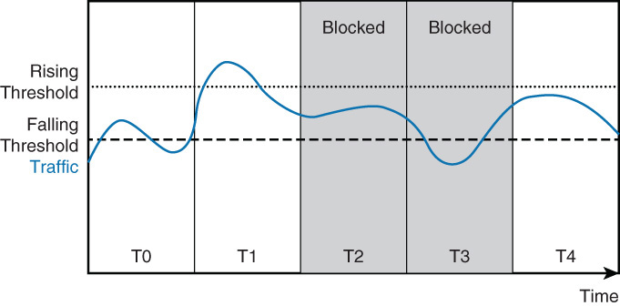
Storm Control
The traffic storm control level is either an absolute number of bits or packets per second or a percentage of the total available bandwidth of the port. Two thresholds can be configured.
When traffic exceeds the rising threshold level, storm control drops the measured traffic for that port. Once the traffic falls under the falling threshold, storm control removes the block.

Slide 44
Storm Control Configuration
Storm control configuration is done per interface for each type of traffic separately.
Storm control is typically configured on access ports, to limit the effect of traffic storm on access level, before it enters the network.
Storm control can be configured on trunk ports and this configuration may be used as a secondary control.
The first step is to configure a rising threshold. Configuration of a falling threshold is optional.
Switch(config)# interface interface-slot/int Switch(config-if)# storm-control [broadcast | multicast | unicast] level{rising- percent | bps rising-bps | pps rising-pps} [falling-percent | falling-bps | falling-pps]
Note that specifying a falling threshold is optional; if omitted, the falling threshold will default to the value of the rising threshold (effectively removing it).
When storm control reaches thresholds, additional actions can be taken, such as putting the interface in an err-disabled state or sending an SNMP trap. Use the following commands to configure these options:
Switch(config)# interface interface-slot/int Switch(config-if)# storm-control action {shutdown | trap}

Slide 45
Storm Control Configuration Example
In this configuration, storm control is configured for the following:
40 percent rising and 25 percent failing thresholds of port bandwidth for broadcast traffic
50,000 packets per second (pps) rising and 25,000 packets per second (pps) failing thresholds for multicast
20,000,000 bits per second (bps) for unicast traffic.
Switch to place ports into err-disable that exceed thresholds
Send an SNMP trap when thresholds reached
Switch(config)# interface GigabitEthernet 0/0/1 Switch(config-if)# storm-control broadcast level 40 25 Switch(config-if)# storm-control multicast level pps 50k 25k Switch(config-if)# storm-control unicast level bps 20m Switch(config-if)# storm-control action shutdown
Switch(config-if)# errdisable recovery cause storm-control Switch(config-if)# storm-control action trap
Switch# show storm-control Interface Filter State Upper Lower Current --------- ------------- ----------- ----------- ---------- Gi0/1 Forwarding 40.00% 25.00% 3.50%

Slide 46

Mitigating Spoofing Attacks
Notes:
Spoofing attacks can occur because several protocols allow a reply from a host even if a request was not received. By spoofing, or pretending to be another machine, the attacker can redirect part or all the traffic coming from, or going to, a predefined target. After the attack, all traffic from the device under attack flows through the attacker’s computer and then to the router, switch, or host.
A spoofing attack can affect hosts, switches, and routers connected to your Layer 2 network by sending false information to the devices connected to the subnet. Spoofing attacks can also intercept traffic intended for other hosts on the subnet. This section describes how to mitigate these attacks and how to configure switches to guard against Dynamic Host Control Protocol (DHCP), MAC, and Address Resolution Protocol (ARP) threats.

Slide 47
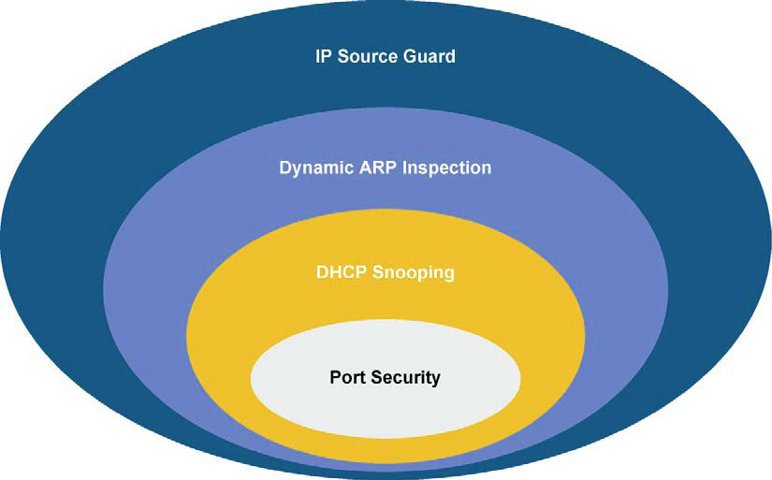
Catalyst Integrated Security Features
Port security prevents MAC flooding attacks.
DHCP snooping prevents client attacks on the DHCP server and switch.
Dynamic Address Resolution Protocol inspection (DAI) adds security to ARP using the DHCP snooping table to minimize the impact of ARP poisoning and spoofing attacks.
IP Source Guard (IPSG) prevents IP spoofing addresses using the DHCP snooping table.
Notes:
The Cisco Catalyst Integrated Security capabilities provide campus security on the Cisco Catalyst switches using integrated tools.
Port Security is covered in the MAC-based attack section of this chapter. DHCP snooping, DAI, and IP source guard can be used to prevent spoof attacks and are covered in depth in this section.

Slide 48
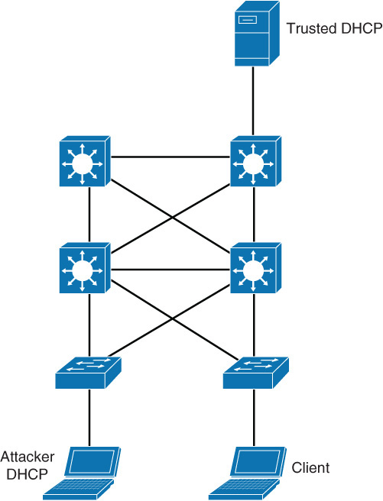
DHCP Spoofing Attack
The most common example of a rogue DHCP server is when a PC is configured as a DHCP server in the campus network
1. Attacker hosts a rogue DHCP server off a switch port to the same subnet as the clients.
2. Client broadcasts a request for DHCP configuration information.
3. The rogue DHCP server responds before the legitimate DHCP server, assigning attacker-defined IP configuration information.
4. Host packets are redirected to the attacker’s address because it emulates a default gateway for the erroneous IP address that is provided to the client via DHCP.
Notes:
DHCP is a protocol used to dynamically assign an IP address and default gateway among other configurations to a client in a network. DHCP is achieved through an exchange of protocol packets between the client and the DHCP server.
DHCP uses four messages to provide an IP address to a client:
DHCP discover broadcast from client
DHCP offer broadcast to client
DHCP unicast request from client
DHCP unicast acknowledgement to client
The following describes the DHCP spoof attack sequence:
Attacker hosts a rogue DHCP server off a switch port.
Client broadcasts a request for DHCP configuration information.
The rogue DHCP server responds before the legitimate DHCP server, assigning attacker-defined IP configuration information.
Host packets are redirected to the attacker’s address as it emulates a default gateway for the erroneous DHCP address provided to the client.

Slide 49
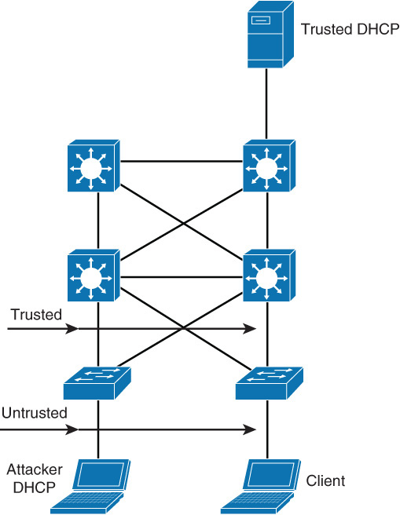
DHCP Snooping
DHCP snooping is a Cisco Catalyst feature that determines which switch ports can respond to DHCP requests. Ports are identified as trusted and untrusted.
Notes:
DHCP snooping is a Cisco Catalyst feature that determines which switch ports can respond to DHCP requests. Ports are identified as trusted and untrusted. Trusted ports can source all DHCP messages, whereas untrusted ports can source requests only. Trusted ports host a DHCP server or can be an uplink toward the DHCP server. If a rogue device on an untrusted port attempts to send a DHCP response packet into the network, the port is shut down. This feature can be coupled with DHCP Option 82, in which switch information, such as the port ID of the DHCP request, can be inserted into the DHCP request packet.
Untrusted ports are those not explicitly configured as trusted. A DHCP binding table is built for untrusted ports. Each entry contains the client MAC address, IP address, lease time, binding type, VLAN number, and port ID recorded as clients make DHCP requests. The table is then used to filter subsequent DHCP traffic. From a DHCP snooping perspective, untrusted access ports should not send any DHCP server responses, such as DHCPOFFER, DHCPACK, or DHCPNAK.

Slide 50
DHCP Snooping
Trusted ports host a DHCP server or can be an uplink toward the DHCP server.
Untrusted ports are those that are not explicitly configured as trusted. From a DHCP snooping perspective, untrusted access ports should not send any DHCP server responses, such as DHCPOFFER, DHCPACK, or DHCPNAK. If a rogue device on an untrusted port attempts to send a DHCP response packet into the network, the port is shut down. This feature can be coupled with DHCP option 82.
DHCP Option 82 DHCP option 82 provides additional security when DHCP is used to allocate network addresses. This feature enables the DHCP relay agent, to include information about itself and the attached client in the DHCP request frames when forwarding DHCP requests from a DHCP client to a DHCP server.
The DHCP server can then use this information to assign IP addresses, perform access control, and set quality of service (QoS) and security policies (or other parameter-assignment policies) for each subscriber of a service provider network.
DHCP option 82 along with DHCP snooping are both best practices for campus networks as an additional security measure.

Slide 51
Configuring DHCP Snooping
Step | Commands
1. | Enable DHCP snooping globally: Switch(config)# ip dhcp snooping
2. | Enable DHCP Option 82: Switch(config)# ip dhcp snooping information option
3. | Configure DHCP server interfaces or uplink ports as trusted: Switch(config-if)# ip dhcp snooping trust
4. | Configure the number of DHCP packets per second (pps) that are acceptable on the port: Switch(config-if)# ip dhcp snooping limit rate rate
5. | Enable DHCP snooping on specific VLANs: Switch(config)# ip dhcp snooping vlan number [number]
6. | Verify the configuration: Switch# show ip dhcp snooping
Notes:
To enable DHCP snooping, use the commands listed in the table.
By default, the feature is not enabled.
This is optional for the forwarded DHCP request packet to contain information on the switch port where it originated.
At least one trusted port must be configured. Use the no keyword to revert to untrusted. By default, all ports are untrusted.
Configure the number of DHCP pps that an interface can receive. Normally, the rate limit applies to untrusted interfaces. This is used to prevent DHCP starvation attacks by limiting the rate of the DHCP requests on untrusted ports.
This is required to identify those VLANs that will be subject to DHCP snooping. Default is no VLANs are enabled for DHCP snooping.
Verify the configuration.
Note: You must globally enable DHCP snooping by using the ip dhcp snooping global configuration command for any DHCP snooping configuration to take effect. You must first globally enable DHCP snooping before enabling DHCP snooping on a VLAN.
When the option-82 feature is enabled and a switch receives a DHCP request from a host, it adds the option-82 information in the packet. The option-82 information contains the switch MAC address (the remote ID suboption) and the port identifier, vlan-mod-port, from which the packet is received (circuit ID suboption). The switch forwards the DHCP request that includes the option-82 field to the DHCP server.
When the DHCP server receives the packet, it can use the remote ID, the circuit ID, or both to assign IP addresses and implement policies, such as restricting the number of IP addresses that can be assigned to a single remote ID or a circuit ID. Then the DHCP server echoes the option-82 field in the DHCP reply.
The DHCP server unicasts the reply to the switch if the request was relayed to the server by the switch. When the client and server are on the same subnet, the server broadcasts the reply. The switch inspects the remote ID and possibly the circuit ID fields to verify that it originally inserted the option-82 data. The switch removes the option-82 field and forwards the packet to the switch port that connects to the DHCP host that sent the DHCP request.

Slide 52
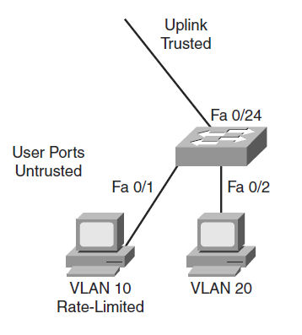
DHCP Snooping Configuration Example
switch(config)# ip dhcp snooping
switch(config)# ip dhcp snooping information option
switch(config)# ip dhcp snooping vlan 10,20
switch(config)# interface fastethernet 0/1
switch(config-if)# description Access Port
switch(config-if)# ip dhcp limit rate 5
switch(config)# interface fastethernet 0/24
switch(config-if)# description Uplink
switch(config-if)# switchport mode trunk
switch(config-if)# switchport trunk allowed vlan 10,20
switch(config-if)# ip dhcp snooping trust
Notes:
This example illustrates a sample DHCP snooping configuration for a simple topology with an access layer switch.

Slide 53
DHCP Snooping – Relay Requests
By default switches that relay DHCP requests will insert option-82 information.
A switch that receives a DHCP frame that has option-82 information on an untrusted interface will drop the frame.
Either need to enable DHCP snooping on the distribution layer switches, trusting the links to the access layer switches, OR
Use the ip dhcp relay information trust-all on the distribution layer switches, without the need to enable DHCP snooping.

Slide 54
Verifying the DHCP Snooping Configuration
To verify the DHCP snooping configuration, use the show ip dhcp snooping command:
switch# show ip dhcp snooping
Switch DHCP snooping is enabled
DHCP snooping is configured on following VLANs:
10,20
DHCP snooping is operational on following VLANs:
10,20
DHCP snooping is configured on the following L3 Interfaces:
Insertion of option 82 is enabled
circuit-id default format: vlan-mod-port
remote-id: 001a.e372.ab00 (MAC)
Option 82 on untrusted port is not allowed
Verification of hwaddr field is enabled
Verification of giaddr field is enabled
DHCP snooping trust/rate is configured on the following Interfaces:
Interface Trusted Allow option Rate limit (pps)
---------------- ------- ------------- ---------------
FastEthernet0/1 no no 5
FastEthernet0/24 yes yes unlimited
Notes:
The show ip dhcp snooping family of commands is used to display information about the DHCP snooping configuration. DHCP snooping is configured for VLANs 10 and 20 and operational on both of them. Only ports that are trusted or that have a rate limit applied will be shown in the output. Interface f0/1 has its rate limited and is not trusted, whereas interface f0/24 does not have any rate limitation and is trusted. All the other ports are untrusted and do not have a rate limit. They are not displayed.

Slide 55
DHCP Snooping Command Review
Command | Comments
ip dhcp snooping | Enables DHCP snooping globally. By default, the feature is not enabled.
ip dhcp snooping information option | Enables DHCP option 82. This is optional for the forwarded DHCP request packet to contain information on the switch port where it originated. This option is enabled by default.
ip dhcp snooping vlan vlan-id [vlan-id] | Identifies VLANs that will be subject to DHCP snooping.
ip dhcp snooping trust | Configures trusted port. Use the no keyword to revert to untrusted. Use this command in the interface configuration mode.
ip dhcp snooping limit rate rate | Configure the number of DHCP packets per second that an interface can receive. This ensures that DHCP traffic will not overwhelm the DHCP servers. Normally, the rate limit applies to untrusted interfaces. Use this command in the interface configuration mode.
show ip dhcp snooping | Verifies the configuration

Slide 56
IP Source Guard
All IP-enabled devices use IP addresses to communicate. One common malicious attack method is to hijack an IP address of a valid host or server. This hijacking is also referred to as IP spoofing.
Catalyst switches support a featured called IP Source Guard (IPSG) that helps protect against IP address spoofing attacks.
IPSG operates by dynamically maintaining per-port VLAN ACLs based on learned IP-to-MAC-to-switch-port bindings.
When IPSG is enabled, the switch blocks all IP traffic into the port except for DHCP packets captured by the DHCP snooping process.
After the DHCP process is complete and the client receives a valid IP address from the DHCP server (or when a static IP source binding is configured by the user), a per-port and VLAN access control list (PVACL) is installed on the port dynamically.
This process restricts the client IP traffic ingress on the respective port to the source IP address that is configured in the binding.
Any IP traffic with a source IP address other than that in the IP source binding will be filtered out.

Slide 57
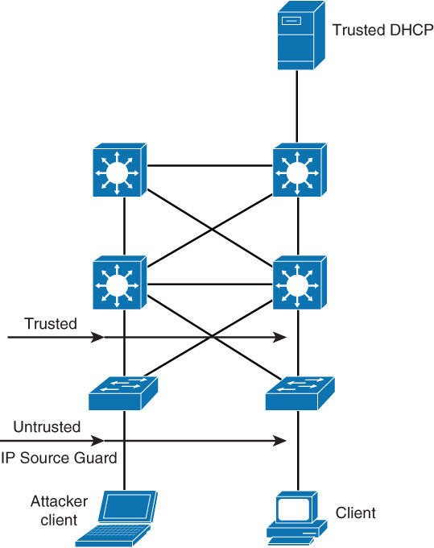
IP Source Guard
IPSG is only supported on Layer 2 ports, including both access and trunk ports.
IPSG labels untrusted ports as those needing the dynamic filtering capability and trusted ports as those that need no IPSG filtering.
For each untrusted port, there are two possible levels of IP traffic security filtering:
Source IP address filter: IP traffic is filtered based on its source IP address. Only IP traffic with a source IP address that matches the IP source binding entry is permitted.
Source IP and MAC address filter: IP traffic is filtered based on its source IP address in addition to its MAC address; only IP traffic with source IP and MAC addresses that match the IP source binding entry are permitted.

Slide 58
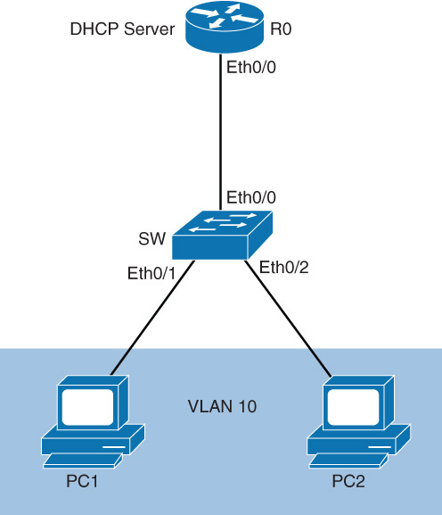
IPSG Configuration
IPSG requires configuration of DHCP snooping because IPSG leverages DHCP snooping to learn valid IP address and MAC address pairs.
To enable IPSG on the port use the ip verify source interface command for enabling IP address filters. To enable MAC address filtering and IP filters, add the ip verify source port-security interface command.
SW(config)# interface Ethernet 0/1 SW(config-if)# ip verify source SW(config-if)# ip verify source port-security SW(config-if)# interface Ethernet0/2 SW(config-if)# ip verify source SW(config-if)# ip verify source port-security
To verify the IPSG configuration, use the show ip verify source command.
SW# show ip verify source Interface Filter-type Filter-mode IP-address Mac-address Vlan --------- ----------- ----------- --------------- ----------------- ---- Et0/1 ip active 192.168.1.4 10 Et0/2 ip active 192.168.1.5 10

Slide 59
ARP Spoofing
ARP spoofing is yet another attack mechanism used by hackers to disrupt networks.
IP-enabled devices use ARP to resolve MAC addresses for IP addresses. When an IP-enabled device sends an ARP request, the device with the corresponding IP address replies with an ARP reply.
The origination device stores the MAC-to-IP mapping in an ARP table that is cached for future use for up to 4 hours.
ARP spoofing works by spoofing an ARP reply from a legitimate device with an invalid MAC.
For example, an attacker may opt to spoof an ARP reply from a router. In this manner, the requested IP-enabled device will receive an ARP reply with a spoofed MAC address and direct further communication to this device instead of the intended router.
At minimum, traffic from the IP-enabled device to the router will be disrupted. It is also possible the attacker could intercept some critical data.

Slide 60
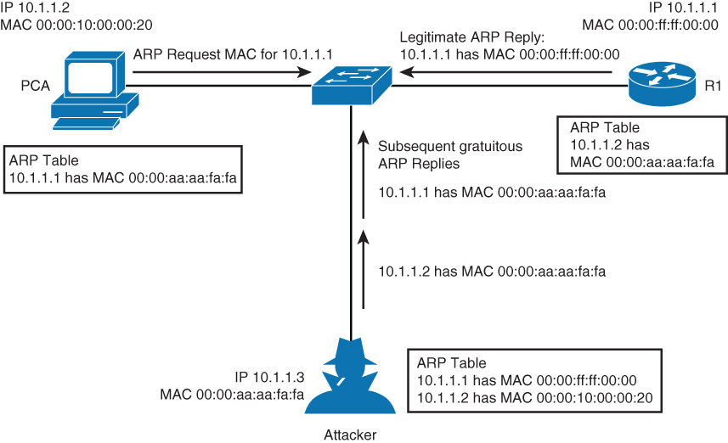
ARP Spoofing Attack
The following steps occur when the attacker ARP spoofs:
Step 1. PCA sends an ARP request for MAC address of R1.
Step 2. R1 replies with its MAC and IP address. It also updates its ARP cache.
Step 3. PCA binds MAC address of R1 to R1’s IP address in its ARP cache.
Step 4. Attacker sends its ARP reply to PCA, binding its MAC address to the IP of R1.
Step 5. PCA updates ARP cache with MAC address of attacker bound to IP address of R1.
Step 6. Attacker sends its ARP reply to R1, binding its MAC address to the IP of PCA.
Step 7. R1 updates ARP cache with MAC address of attacker bound to IP address of PCA.
Step 8. Packets are diverted through attacker.
Notes:
In a normal ARP operation, a host sends a broadcast to determine the MAC address of a host with a particular IP address. The device at that IP address replies with its MAC address. The originating host caches the ARP response, using it to populate the destination Layer 2 header of packets sent to that IP address.
By spoofing an ARP reply from a legitimate device with a gratuitous ARP, an attacking device appears to be the destination host sought by the senders. The ARP reply from the attacker causes the sender to store the MAC address of the attacking system in its ARP cache. All packets destined for those IP addresses are forwarded through the attacker system.
An ARP spoofing attack follows the sequence shown above, referencing the figure.

Slide 61
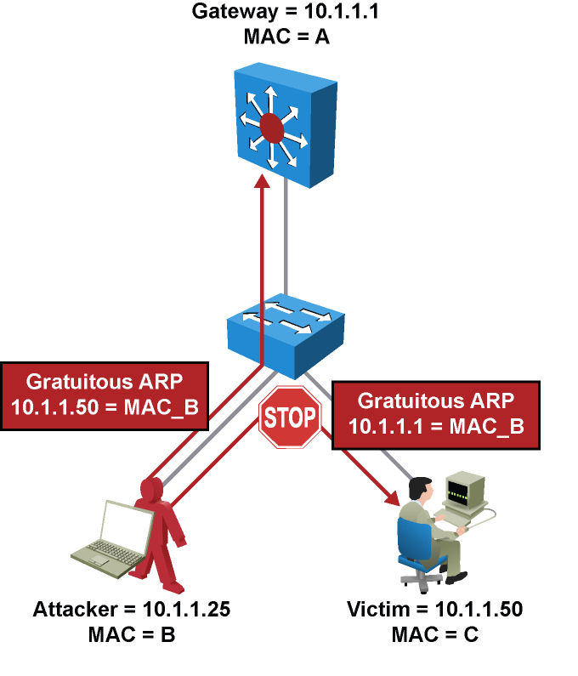
Dynamic ARP Inspection (DAI)
DAI takes these actions:
Forwards ARP packets received on a trusted interface without any checks.
Intercepts all ARP packets on untrusted ports.
Verifies that each intercepted packet has a valid IP-to-MAC address binding before forwarding packets that can update the local ARP cache.
Drops and logs ARP packets with invalid IP-to-MAC address bindings.
Notes:
ARP does not have any authentication. It is quite simple for a malicious user to spoof addresses by using tools such as ettercap, dsniff, and arpspoof to poison the ARP tables of other hosts on the same VLAN. In a typical attack, a malicious user can send unsolicited ARP replies (gratuitous ARP packets) to other hosts on the subnet with the attacker’s MAC address and the default gateway’s IP address. Frames intended for default gateways sent from hosts with poisoned ARP tables are sent to the hacker’s machine (enabling the packets to be sniffed) or an unreachable host as a DoS attack. ARP poisoning leads to various man-in-the-middle attacks, posing a security threat in the network.
Dynamic ARP inspection (DAI) helps prevent the man-in-the-middle attacks by not relaying invalid or gratuitous ARP replies out to other ports in the same VLAN, as shown in the figure. Dynamic ARP inspection intercepts all ARP requests and all replies on the untrusted ports. Each intercepted packet is verified for valid IP-to-MAC bindings that are gathered via DHCP snooping. Denied ARP packets are either dropped or logged by the switch for auditing, so ARP poisoning attacks are stopped. Incoming ARP packets on the trusted ports are not inspected. Dynamic ARP inspection can also rate-limit ARP requests from client ports to minimize port scanning mechanisms.
To prevent ARP spoofing or ARP poisoning, a switch must ensure that only valid ARP requests and responses are relayed. DAI prevents these attacks by intercepting and validating all ARP requests and responses. Each intercepted ARP reply is verified for valid MAC-address-to-IP-address bindings before it is forwarded to a PC to update the ARP cache. ARP replies coming from invalid devices are dropped.
DAI determines the validity of an ARP packet based on a valid MAC-address-to-IP-address bindings database built by DHCP snooping. In addition, to handle hosts that use statically configured IP addresses, DAI can also validate ARP packets against user-configured ARP ACLs.
Configure all access switch ports as untrusted and all switch ports connected to other switches as trusted. In this case, all ARP packets entering the network would be from an upstream distribution or core switch, bypassing the security check and requiring no further validation.

Slide 62
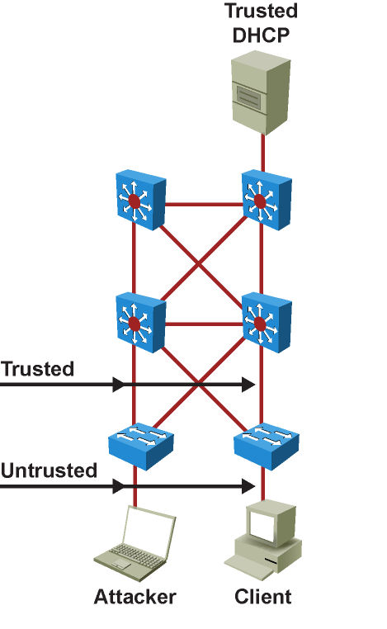
DAI Recommended Configuration
It is best practice to configure all access switch ports as untrusted and all switch ports that are connected to other switches as trusted.
In this case, all ARP packets that are entering the network would be from an upstream distribution or core switch, bypassing the security check and requiring no further validation.

Slide 63
DAI Configuration
The DAI configuration is straightforward and relies on DHCP snooping configuration similar to IPSG. The following steps are the recommended practice for configuring DHCP spoofing:
Step 1. Implement protection against DHCP spoofing:
a. Enable DHCP snooping globally.
b. Enable DHCP snooping on selected VLANs.
Step 2. Enable DAI: Enable ARP inspection on selected VLANs.
Step 3. Configure trusted interfaces for DHCP snooping and ARP inspection (untrusted is default).

Slide 64
DAI Configuration Example
SW(config)# ip dhcp snooping SW(config)# ip dhcp snooping vlan 10 SW(config)# ip arp inspection vlan 10 SW(config)# interface Ethernet 0/0 SW(config-if)# ip dhcp snooping trust SW(config-if)# ip arp inspection trust

Slide 65

Securing VLAN Trunks
Notes:
On networks using trunking protocols, there is a possibility of rogue traffic “hopping” from one VLAN to another, thereby creating security vulnerabilities.

Slide 66
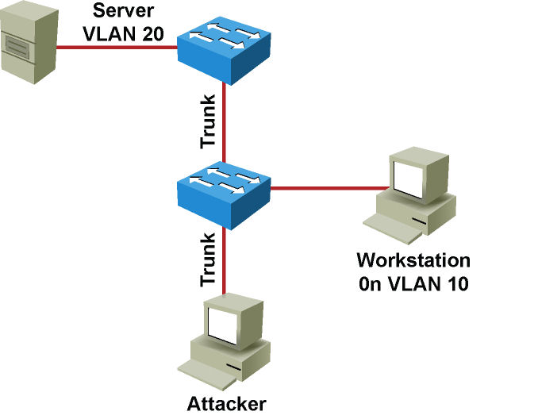
VLAN Hopping
Switch Spoofing
Double Tagging
Notes:
VLAN hopping is a network attack whereby an end system sends packets to, or collects packets from, a VLAN that should not be accessible to that end system. This is accomplished by tagging the invasive traffic with a specific VLAN ID (VID) or by negotiating a trunk link to send or receive traffic on penetrated VLANs. VLAN hopping can be accomplished by switch spoofing or double tagging.
VLAN hopping attacks refer to a malicious device attempting to access VLANs for which it is not configured. There are two forms of VLAN hopping attacks.

Slide 67
VLAN Hopping – Switch Spoofing (1)
An attacker can send a malicious DTP frame. Upon receiving the frame, the switch would form a trunk port, which would then give the attacker access to all the VLANs on the trunk. The attacker port becomes a trunk port, and the attacker can attack a victim in any VLAN carried on the trunk.
Notes:
The first form of VLAN hopping leverages the default configuration of the Catalyst switch port. Cisco Catalyst switches enable trunking in auto mode by default. As a result, the interface becomes a trunk upon receiving a DTP frame. An attacker can use this default behavior to access VLANs configured on the switch through one of two methods (first one shown above).
The following list describes the switch spoofing sequence of events:
Attacker gains access to a switch port and sends DTP negotiation frames toward a switch with DTP running and auto negotiation turned on (often, the default settings).
Attacker and switch negotiate trunking over the port.
Switch enables all VLANs (default) to traverse the trunk link.
Attacker sends data to, or collects it from, all VLANs carried on that trunk.

Slide 68
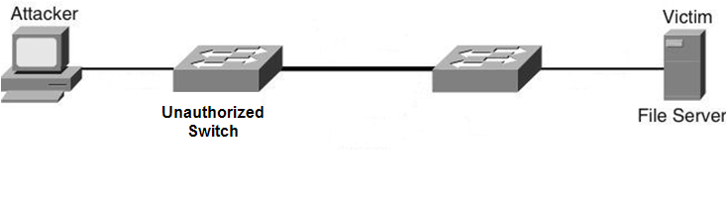
VLAN Hopping – Switch Spoofing (2)
In another type of switch spoofing attack, the network attacker connects an unauthorized Cisco switch to the switch port. The unauthorized switch can send DTP frames and form a trunk. The attacker has access to all the VLANs through the trunk. The attacker can attack a victim in any VLAN.
Notes:
The first form of VLAN hopping leverages the default configuration of the Catalyst switch port. Cisco Catalyst switches enable trunking in auto mode by default. As a result, the interface becomes a trunk upon receiving a DTP frame. An attacker can use this default behavior to access VLANs configured on the switch through one of two methods (second one shown above).

Slide 69
Mitigating Switch Spoofing
There are several mechanisms or best practices to minimize authorized access to trunk ports and switch spoofing, including the following:
Manually configure access ports
SW(config)# interface interface-slot/number SW(config-if)# switchport mode access SW(config-if)# switchport access vlan vlan-id
Shut down unused interfaces
SW(config)# interface interface-slot/number SW(config-if)# shutdown
Restrict VLANs on trunk ports
SW(config)# interface interface-slot/number SW(config-if)# switchport trunk allowed vlan vlan-list
Switch(config)# interface GigabitEthernet 1/1 Switch(config-if)# switchport mode access Switch(config-if)# switchport access vlan 100 Switch(config)# interface GigabitEthernet 2/1 Switch(config)# shutdown Switch(config)# interface GigabitEthernet 3/1 Switch(config)# switchport trunk allowed vlan 2-10

Slide 70
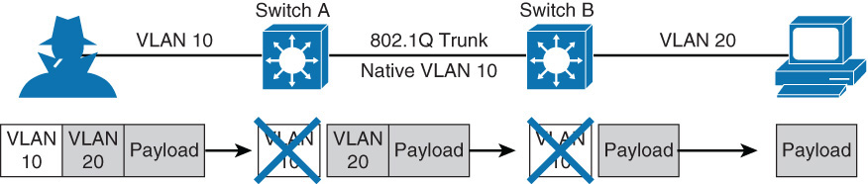
VLAN Hopping – Double Tagging
The circumstances are as follows:
The IP-enabled device the attacker is using must be connected to an access port.
The IP-enabled device must send a double-tagged frame.
The first-hop switch must be configured to accept 802.1Q frames.
The first-hop switch must be connected to another switch with an 802.1Q truck, and its native VLAN must match the attackers outer VLAN tag.
Notes:
The second form of VLAN hopping attack is possible even if the trunking feature is turned off on the switch port. The attack involves sending frames with a double 802.1Q tag. This attack requires the client to be on a switch other than the attacking switch. Another requirement is that these two switches must be connected in the same VLAN as the attacking switch port or native VLAN of the trunk between the switch and the attacked VLAN.
In this method of VLAN hopping, any workstation can generate frames with two 802.1Q headers to cause the switch to forward the frames onto a VLAN that would be inaccessible to the attacker through legitimate means.
The first switch to encounter the double-tagged frame strips the first tag off the frame, because the first tag (VLAN 10) matches the trunk port native VLAN, and then forwards the frame out.
The result is that the frame is forwarded, with the inner 802.1Q tag, out all the switch ports as the switch does not have the MAC address in the table because the switch does not recognize that there is a second tag., including trunk ports configured with the native VLAN of the network attacker. The second switch then forwards the packet to the destination based on the VLAN ID in the second 802.1Q header. If the trunk does not match the native VLAN of the attacker, the frame would be untagged and flooded to only the original VLAN.

Slide 71
VLAN Hopping – Double Tagging
Step 1. Attacker (native VLAN 10) sends a frame with two 802.1Q headers to Switch 1.
Step 2. Switch 1 strips the outer tag and forwards the frame to all ports within same native VLAN.
Step 3. Switch 2 interprets frame according to information in the inner tag marked with VLAN ID 20.
Step 4. Switch 2 forwards the frame out all ports associated with VLAN 20, including trunk ports.
Notes:
The second form of VLAN hopping attack is possible even if the trunking feature is turned off on the switch port. The attack involves sending frames with a double 802.1Q tag. This attack requires the client to be on a switch other than the attacking switch. Another requirement is that these two switches must be connected in the same VLAN as the attacking switch port or native VLAN of the trunk between the switch and the attacked VLAN.
In this method of VLAN hopping, any workstation can generate frames with two 802.1Q headers to cause the switch to forward the frames onto a VLAN that would be inaccessible to the attacker through legitimate means.
The first switch to encounter the double-tagged frame strips the first tag off the frame, because the first tag (VLAN 10) matches the trunk port native VLAN, and then forwards the frame out.
The result is that the frame is forwarded, with the inner 802.1Q tag, out all the switch ports as the switch does not have the MAC address in the table because the switch does not recognize that there is a second tag., including trunk ports configured with the native VLAN of the network attacker. The second switch then forwards the packet to the destination based on the VLAN ID in the second 802.1Q header. If the trunk does not match the native VLAN of the attacker, the frame would be untagged and flooded to only the original VLAN.

Slide 72
Mitigating VLAN Hopping Attack (double tagging)
Because an attacker’s port VLAN must match the native VLAN of a trunk, the simple solution is to configure the native VLAN of all trunk ports to an unused VLAN.
SW(config)# interface interface-slot/number SW(config-if)# switchport trunk native vlan vlan-id
An alternate method is to prune the native VLAN from the trunk.
SW(config)# interface interface-slot/number SW(config-if)# switchport trunk native vlan vlan-id SW(config-if)# switchport trunk allowed vlan remove vlan-id
Yet another option is to tag all frames on trunk ports by default.
SW(config)# vlan dot1q tag native
Example:
SW(config)# interface gigabitEthernet 1/1 SW(config-if)# switchport trunk native vlan 999 SW(config)# interface gigabitEthernet 1/1 SW(config-if)# switchport trunk native vlan 999 SW(config-if)# switchport trunk allowed vlan remove 999 SW(config-if)# vlan dot1q tag native
Notes:
The measures to defend the network from VLAN hopping are a series of best practices for all switch ports and parameters to follow when establishing a trunk port.
Other methods to ensure VLAN security is using private VLAN’s to segregate users and using VLAN ACL’s to filter traffic within the same VLAN. Private VLAN’s are explained in more detail in Chapter 2, “Implementing VLAN’s in Campus Networks.” For more information about best practices for configuring Catalyst switches, refer to the following URL on Cisco.com: www.cisco.com/en/US/products/hw/switches/ps700/products_white_paper09186a00801b49a4.shtml

Slide 73
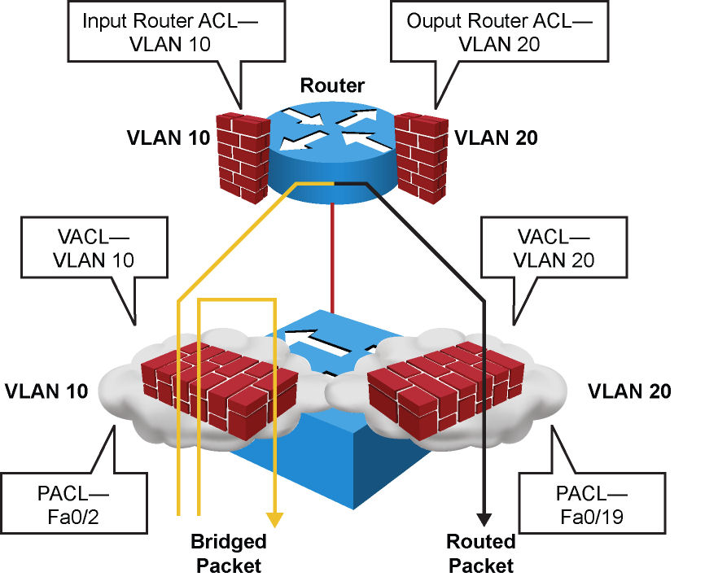
Catalyst Multilayer Switch ACL Types
Router access control lists (RACL): Supported in the TCAM hardware on Cisco multilayer switches. In Catalyst switches, RACL can be applied to any routed interface, such as an SVI or routed port.
Port access control list (PACL): Filters traffic at the port level. PACL’s can be applied on a Layer 2 switch port, trunk port, or EtherChannel port. PACL’s act at the Layer 2 port level but can filter based on Layer 3/Layer 4 information.
VACL’s: Also known as VLAN access-maps, apply to all traffic in a VLAN. VACL’s support filtering based on Ethertype and MAC addresses. VACL’s are order-sensitive, analogous to route maps. VACL’s can control traffic flowing within the VLAN or control switched traffic, whereas RACL’s control only routed traffic.
Notes:
Access This topic describes VACL’s and their purpose as part of VLAN security. Cisco multilayer switches support three types of ACLs, as shown in the figure.
Catalyst switches support four ACL lookups per packet: input and output security ACL and input and output quality of service (QoS) ACL.
The process of combining the ACEs from multiple feature ACLs is known as the ACL merge. Catalyst switches use two methods of performing a merge: order independent and order dependent. With order-independent merge, ACLs are transformed from a series of order-dependent actions to a set of order-independent masks and patterns. The resulting access control entry (ACE) can be large. The merge is processor- and memory-intensive.
Order-dependent merge is a recent improvement on some Catalyst switches in which ACLs retain their order-dependent aspect. The computation is much faster and is less processor-intensive.
For more information on order-dependent merge, refer to the following URL on Cisco.com: www.cisco.com/warp/public/cc/pd/si/casi/ca6000/tech/65acl_wp.pdf
ACLs are supported in hardware through IP standard ACLs and IP extended ACLs, with permit and deny actions. ACL processing is an intrinsic part of the packet forwarding process. ACL entries are programmed in hardware. Lookups occur in the pipeline, whether ACLs are configured. This enables ACLs to effectively provide filtering at linerate on a Catalyst switch and therefore can be used for security.
Note: RACL’s and PACL’s are covered in CCNA courses.

Slide 74
VLAN Access Lists
VLAN access lists (VACLs) can provide access control for all packets that are bridged within a VLAN or packets that are routed into or out of a VLAN or a WAN interface.
Unlike Cisco IOS ACLs that are applied on routed packets only, VACLs apply to all packets and can be applied to any VLAN or WAN interface.
You can configure VACLs for IP or MAC layer traffic with some limitations depending on platform and software version.
Each VLAN access map can consist of one or more map sequences; each sequence has a match clause and an action clause.
The match clause specifies IP or MAC ACLs for traffic filtering, and the action clause specifies the action to be taken when a match occurs.
When a flow matches a permit ACL entry, the associated action is taken, and the flow is not checked against the remaining sequences.
When a flow matches a deny ACL entry, it will be checked against the next ACL in the same sequence or the next sequence.
If a flow does not match any ACL entry and at least one ACL is configured for that packet type, the packet is denied.

Slide 75
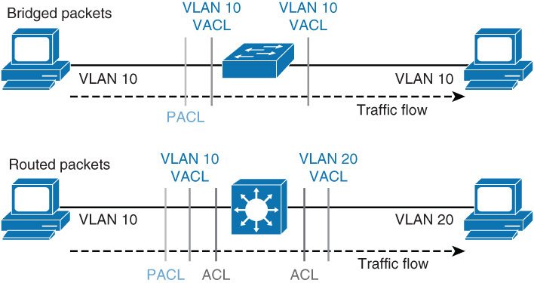
VACL Interaction with ACLs and PACLs
VACLs, Layer 3 ACLs on routed interfaces, and PACLs work together seamlessly; however, care must be taken when engineering these filtering techniques together.
For an incoming packet on a physical port, the PACL is applied first. If the packet is permitted by the PACL, the VACL on the ingress VLAN is applied next. If the packet is Layer 3 forwarded and is permitted by the VACL, it is filtered by the Cisco IOS ACLs on the same VLAN. The same process happens in reverse in the egress direction. However, there is currently no hardware support for output PACLs.

Slide 76
Configuring VACL’s
Step 1. Define a VLAN access map:
Switch(config)# vlan access-map map_name [seq#]
Step 2. Configure a match clause:
Switch(config-access-map match {ip | ipv6} address ip-access-list / match mac address mac-access-list
Step 3. Configure an action clause:
Switch(config-access-map)# action {drop [log]} | {forward [capture]} | {redirect {{fastethernet | gigabitethernet | tengigabitethernet} slot/port} | {port-channel channel_id}}
Step 4. Apply a map to VLANs:
Switch(config)# vlan filter map_name vlan_list list
Step 5. Verify the VACL configuration:
Switch# show vlan access-map map_name
Switch# show vlan filter [ access-map map_name | vlan vlan_id ]
Notes:
VACLs (also called VLAN access maps) apply to all traffic on the VLAN. You can configure VACLs for IP- and MAC-layer traffic. VACLs follow route-map conventions, in which map sequences are checked in order. When a matching permit ACE is encountered, the switch takes the action. When a matching deny ACE is encountered, the switch checks the next ACL in the sequence or checks the next sequence.
To configure VACLs, complete the 5 steps above.

Slide 77
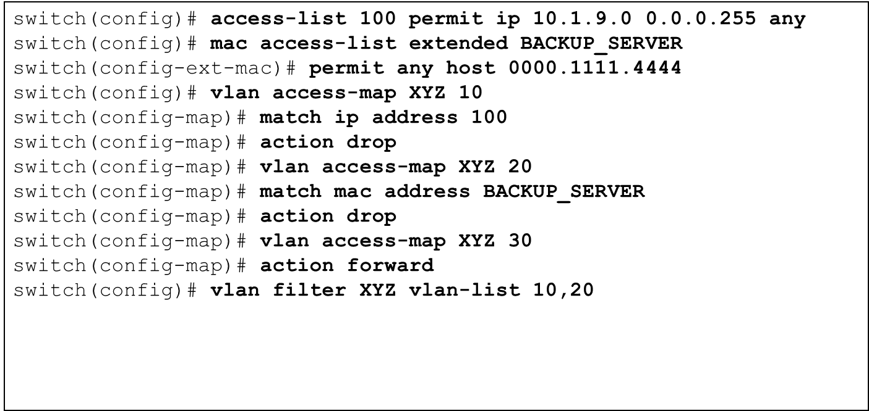
Configuring VACL’s Example
Here a VACL is configured to drop all traffic from network 10.1.9.0/24 on VLAN 10 and 20 and drop all traffic to Backup Server 0000.1111.4444.

Slide 78
Private VLANs
Notes:
Network security vulnerabilities include loss of privacy, data theft, impersonation, and loss of integrity. Basic security measures should be taken on every network to mitigate adverse effects of user negligence or acts of malicious intent. Best practices following these general steps are required whenever placing new equipment in service.
Step 1. Consider or establish organizational security policies.
Step 2. Secure switch device and protocols.
Step 3. Mitigate compromises launched through a switch.

Slide 79
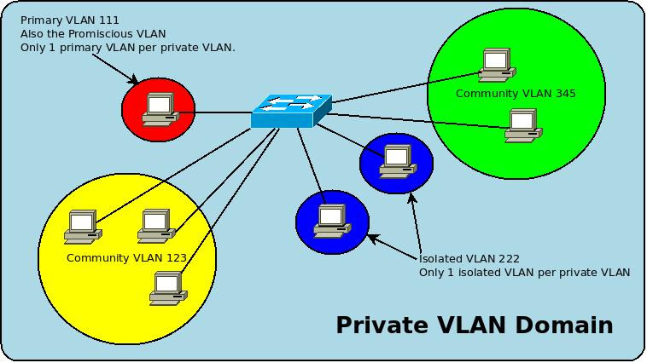
Motivation for Private VLANs
Service providers often have devices from multiple clients, in addition to their own servers, in a single Demilitarized Zone (DMZ) segment or VLAN. As security issues abound, it becomes more important to provide traffic isolation between devices, even though they might exist on the same Layer 3 segment and VLAN.
Most Cisco IOS-based switches implement private VLANs to keep some switch ports shared and some switch ports isolated, even though all ports remain in the same VLAN.

Slide 80
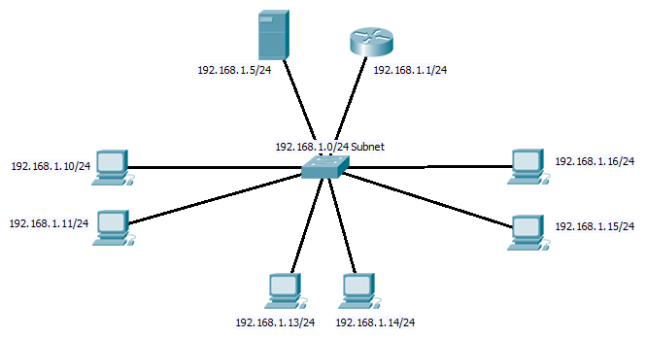
Private VLANs
Promiscuous Ports
Community VLAN A Ports
Isolated VLAN C Ports
Community VLAN B Ports
VTP Transparent
Private VLANs (pVLAN) provide isolation between ports within the same VLAN.
pVLANs require VTP switches to be in transparent mode.
pVLANs can go across trunks.

Slide 81
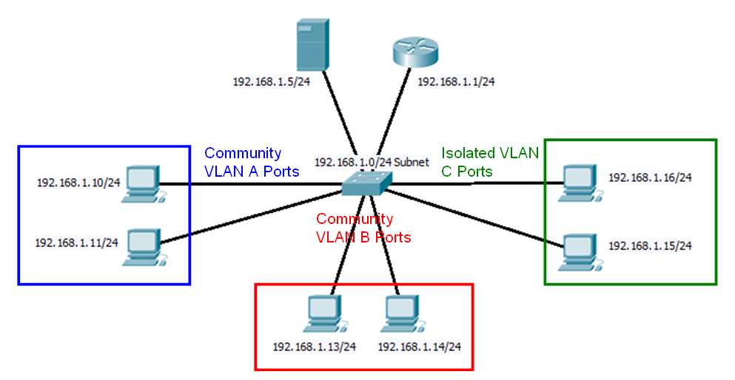
Private VLANs
Promiscuous Ports
Same subnet but different pVLANs
pVlans:
Provide security
Reduce the number of IP subnets
Service providers use pVLANs to deploy hosting services and network access where all devices reside in the same subnet but only communicate to a default gateway, servers or another network.

Slide 82
Private VLANs
Primary VLANs
Promiscuous Ports
Secondary VLANs
pVlans consist of two supporting VLANs:
Primary VLAN
High-level VLAN
Can have many secondary VLANs
Secondary VLANs belong to same subnet as Primary VLAN
Secondary VLAN
Child to a Primary
End devices belong to a secondary VLAN

Slide 83
Private VLANs
Promiscuous Ports
Community VLANs
Isolated VLANs
Two types of secondary VLANs
Community VLANs
These ports communicate with other ports in the same community and promiscuous ports
Isolated VLANs
These ports can only communicate with promiscuous ports.

Slide 84
Private VLANs
Promiscuous Ports
Community VLAN A Ports
Isolated VLAN C Ports
Community VLAN B Ports
Community VLANs ports communicate with other ports in the same community and promiscuous ports.
What devices can Community VLAN A PCs communicate with?
What devices can Community VLAN B PCs communicate with?
Isolated VLANs ports can only communicate with promiscuous ports.
What devices can Isolated VLAN C PCs communicate with?

Slide 85
Configuring pVLANs: Creating the pVLANs
Switch(config)# vlan 100
Switch(config-vlan)# private-vlan primary
Switch(config)# vlan 200
Switch(config-vlan)# private-vlan community
Switch(config)# vlan 201
Switch(config-vlan)# private-vlan community
Switch(config)# vlan 300
Switch(config-vlan)# private-vlan isolated
Switch(config)# vlan 100
Switch(config-vlan)# private-vlan association 200,201,300
Switch(config)# interface vlan 100
Switch(config-if)# private-vlan mapping add 200,201,300
Primary VLANs
Secondary VLANs
Configure Primary VLAN
Configure Secondary VLANs (two community, one isolated)
Associate secondary VLANs to primary VLAN
Map secondary VLANs to Layer 3 VLAN interface of primary VLAN to allow Layer 3 switching (later).

Slide 86
Private VLANs
Promiscuous Ports
VLAN 100
Community VLAN A Ports
Isolated VLAN C Ports
VLAN 200
VLAN 300
VLAN 201
Community VLAN B Ports
Switch(config)# vlan 100
Switch(config-vlan)# private-vlan primary
Switch(config)# vlan 200
Switch(config-vlan)# private-vlan community
Switch(config)# vlan 201
Switch(config-vlan)# private-vlan community
Switch(config)# vlan 300
Switch(config-vlan)# private-vlan isolated
Switch(config)# vlan 100
Switch(config-vlan)# private-vlan association 200,201,300
Switch(config)# interface vlan 100
Switch(config-if)# private-vlan mapping add 200,201,300

Slide 87
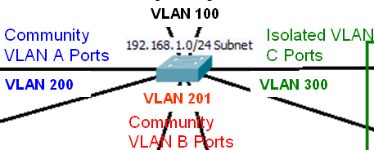
Configuring pVLANs: Port Association
Switch(config)# interface range fa 0/1 – 5
Switch(config-if)# switchport mode private-vlan promiscuous
Switch(config-if)# exit
Switch(config)# interface range fa 0/10 – 11
Switch(config-if)# switchport mode private-vlan host
Switch(config-if)# switchport private-vlan host-association 100 200
Switch(config-if)# exit
Switch(config)# interface range fa 0/13 – 14
Switch(config-if)# switchport mode private-vlan host
Switch(config-if)# switchport private-vlan host-association 100 201
Switch(config-if)# exit
Switch(config)# interface range fa 0/15 – 16
Switch(config-if)# switchport mode private-vlan host
Switch(config-if)# switchport private-vlan host-association 100 300
Switch(config-if)# exit
Primary
Secondary
Configure access ports for promiscuous mode.
Configure access ports for community pVLANs.
Configure access ports for isolated pVLANs.

Slide 88
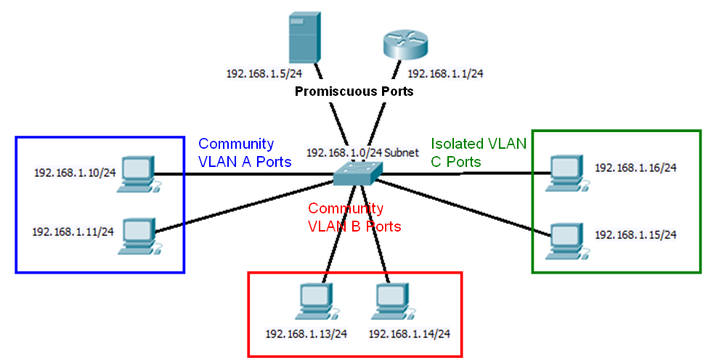
Configuring pVLANs - Review
Switch(config)# vlan 100
Switch(config-vlan)# private-vlan primary
Switch(config)# vlan 200
Switch(config-vlan)# private-vlan community
Switch(config)# vlan 201
Switch(config-vlan)# private-vlan community
Switch(config)# vlan 300
Switch(config-vlan)# private-vlan isolated
Switch(config)# vlan 100
Switch(config-vlan)# private-vlan association 200,201,300
Switch(config)# interface vlan 100
Switch(config-if)# private-vlan mapping add 200,201,300

Slide 89
VLAN 200
VLAN 300
VLAN 201
Switch(config)# interface range fa 0/1 – 5
Switch(config-if)# switchport mode private-vlan promiscuous
Switch(config-if)# exit
Switch(config)# interface range fa 0/10 – 11
Switch(config-if)# switchport mode private-vlan host
Switch(config-if)# switchport private-vlan host-association 100 200
Switch(config-if)# exit
Switch(config)# interface range fa 0/13 – 14
Switch(config-if)# switchport mode private-vlan host
Switch(config-if)# switchport private-vlan host-association 100 201
Switch(config-if)# exit
Switch(config)# interface range fa 0/15 – 16
Switch(config-if)# switchport mode private-vlan host
Switch(config-if)# switchport private-vlan host-association 100 300
Switch(config-if)# exit
Primary
Secondary

Slide 90
Configuring pVLANs - Steps
Step 1. Set VTP mode to transparent.
Step 2. Create the secondary pVLANs.
Step 3. Create the primary pVLAN.
Step 4. Associate the secondary pVLAN with the primary pVLAN.
Only one isolated pVLAN can be mapped to a primary pVLAN, but more than one community pVLAN can be mapped to a primary pVLAN.
Step 5. Configure an interface as an isolated or community port.
Step 6. Associate the isolated port or community port with the primary-secondary pVLAN pair.
Step 7. Configure an interface as a promiscuous port.
Step 8. Map the promiscuous port to the primary-secondary pVLAN pair.

Slide 91
Configuring pVLANs - Commands
Switch(config)# vlan pvlan-id
Switch(config-vlan)# private-vlan {community | isolated | primary}
Switch(config-vlan)# exit
Switch(config)# vlan primary-vlan-id
Switch(config-vlan)# private-vlan association {secondary-vlan-list | add secondary-vlan-list | remove secondary-vlan-list}
Switch(config-vlan)# interface vlan primary-vlan-id
Switch(config-if)# private-vlan mapping {secondary-vlan-list | add secondary-vlan-list | remove secondary-vlan-list}
Switch(config-if)# interface type slot/port
Switch(config-if)# switchport
Switch(config-if)# switchport mode private-vlan {host | promiscuous}
Switch(config-if)# switchport private-vlan host-association primary-vlan-id secondary-vlan-id
Switch(config-if)# switchport private-vlan mapping primary-vlan-id {secondary-vlan-list | add secondary-vlan-list | remove secondary-vlan-list}

Slide 92
Verifying pVLAN Configuration
The two most useful commands for this purpose are show interface switchport and show vlan private-vlan.
Switch# show vlan private-vlan
Primary Secondary Type Interfaces
------- --------- -------------- -----------------
100 200 community
100 300 isolated
Switch# show interfaces FastEthernet 5/2 switchport
Name: Fa5/2
Switchport: Enabled
Administrative Mode: private-vlan host
Operational Mode: down
Administrative Trunking Encapsulation: negotiate
Negotiation of Trunking: On
Access Mode VLAN: 1 (default)
Trunking Native Mode VLAN: 1 (default)
Administrative private-vlan host-association: 100 (VLAN0200) 300 (VLAN0300)
Administrative private-vlan mapping: none
Operational private-vlan: none
Trunking VLANs Enabled: ALL
Pruning VLANs Enabled: 2-1001
Capture Mode Disabled

Slide 93
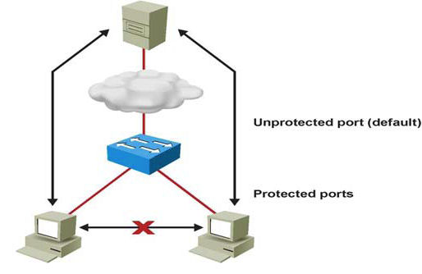
pVLAN Edge (Protected Port) Feature
The PVLAN edge (protected port) feature has only local significance to the switch (unlike pVLANs), and there is no isolation provided between two protected ports located on different switches.
A protected port does not forward any traffic to any other port that is also a protected port on the same switch.
Traffic cannot be forwarded between protected ports at L2, all traffic passing between protected ports must be forwarded through an L3 device.
Switch(config-if)# switchport protected

Slide 94
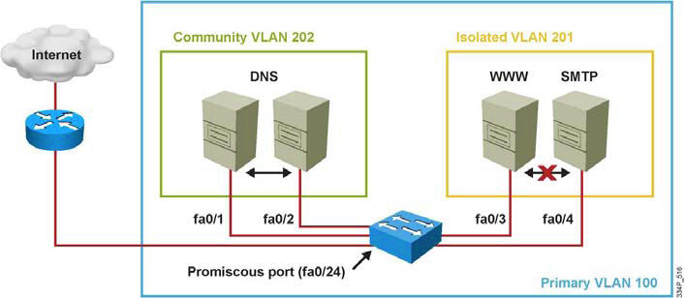
pVLAN Scenario 1: Single Switch
A corporate DMZ contains two DNS servers, one web server and one SMTP server. All servers and their connecting router are in the same subnet.
DNS servers are redundant copies, so they need to communicate with each other to update their entries and to the Internet. In addition to that, they also need to communicate with the Internet.
The Web Server and the SMTP server need to communicate with the Internet, but for security purposes, the SMTP server should not be reachable from the Web or the DNS servers. The web server needs to be accessible from the Internet but not from the SMTP server.
Notes:
Network designers could solve this using ACLs but pVLANs are a simpler solution. The port to the Internet should be set to promiscuous. A community VLAN should be created to host both DNS servers and an isolated VLAN should be created to host the Web and SMTP servers.

Slide 95
pVLAN Configuration for Scenario 1
Switch(config)# vtp transparent
Switch(config)# vlan 201
Switch(config-vlan)# private-vlan isolated
Switch(config)# vlan 202
Switch(config-vlan)# private-vlan community
Switch(config-vlan)# vlan 100
Switch(config-vlan)# private-vlan primary
Switch(config-vlan)# private-vlan association 201,202
Switch(config-vlan)# interface fastethernet 0/24
Switch(config-if)# switchport mode private-vlan promiscuous
Switch(config-if)# switchport private-vlan mapping 100 201,202
Switch(config-if)# interface range fastethernet 0/1 - 2
Switch(config-if)# switchport mode private-vlan host
Switch(config-if)# switchport private-vlan host-association 100 202
Switch(config-if)# interface range fastethernet 0/3 - 4
Switch(config-if)# switchport mode private-vlan host
Switch(config-if)# switchport private-vlan host-association 100 201
Notes:
When the pVLANs are defined, configure each port to associate to a pVLAN mode. Interface fastethernet 0/1 and fastethernet 0/2 are DNS ports, so associate pVLAN 100 to 202. Interface fastethernet 0/3 and fastethernet 0/4 are WWW and SMTP servers, so associate pVLAN 100 to 201. pVLANs 201 and 202 are mapped to the promiscuous port as a result of being associated with primary pVLAN 100. Traffic can flow to and from pVLAN 201 and 202 and to and from the promiscuous port that is a router port on interface 0/24. Keep in mind that all devices in pVLAN 201, pVLAN 202, and on the promiscuous port are in the same subnet.

Slide 96
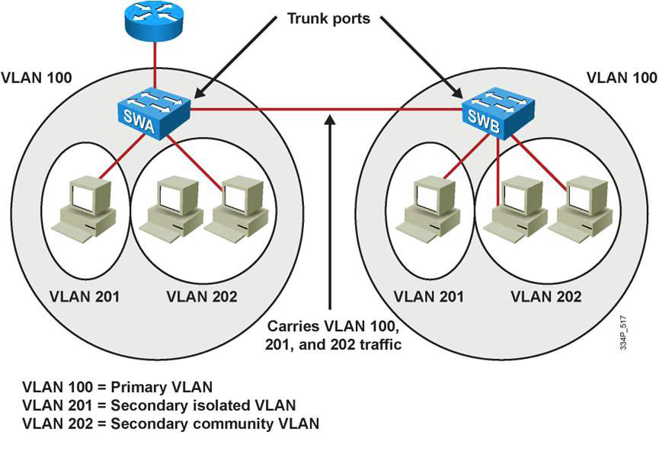
pVLAN Scenario 2: Multiple Switches
A trunk port carries the primary VLAN and secondary VLANs to a neighboring switch just like any other VLAN.
A feature of pVLANs across multiple switches is that traffic from an isolated port in one switch does not reach an isolated port on another switch.
Configure pVLANs on all switches on the path, which includes devices that have no pVLAN ports to maintain the security of your pVLAN configuration, and avoid using other VLANs configured as pVLANs.
As shown in the figure, the switches SWA and SWB have the same pVLANs on two different switches and are connected through the trunk link.
Notes:
Because VTP does not support pVLANs, configure the pVLANs manually on all switches in the Layer 2 network. If the primary and secondary VLAN association in some switches but not all in the network, the Layer 2 databases in these switches are not merged. This situation can result in unnecessary flooding of Private VLAN traffic on those switches.
To trunk pVLANs on a host port or a port that is supposed to carry multiple secondary VLANs, the pVLAN trunk feature is also available. A pVLAN trunk port can carry multiple secondary and non-Private VLANs. Packets are received and transmitted with secondary or regular VLAN tags on the pVLAN trunk ports.
Only IEEE 802.1q encapsulation is supported. Isolated trunk ports enable you to combine traffic for all secondary ports over a trunk. Promiscuous trunk ports enable you to combine the multiple promiscuous ports required in this topology in a single trunk port that carries multiple primary VLANs. The following are some guidelines for using the pVLAN trunk feature:
Use isolated pVLAN trunk ports when you anticipate the use of pVLAN isolated host ports to carry multiple VLANs, either normal VLANs or for multiple pVLAN domains. This makes it useful for connecting a downstream switch that does not support pVLANs.
pVLAN promiscuous trunks are used in situations where a pVLAN promiscuous host port is normally used but where it is necessary to carry multiple VLANs, either normal VLANs or for multiple pVLAN domains. This makes it useful for connecting an upstream router that does not support pVLANs.

Slide 97
pVLAN Configuration for Scenario 2
To configure a Layer 2 interface as a Private VLAN trunk port, use the interface command:
Switch(config-if)# switchport private-vlan association trunk primary_vlan_ID secondary_vlan_ID
If the port is set to promiscuous, use the mapping command:
Switch(config-if)# switchport private-vlan mapping primary_vlan_ID secondary_vlan_list
Once the trunk is configured, allow VLANs with the command
Switch(config-if)# switchport private-vlan trunk allowed vlan vlan_list
Configure the native VLAN with following command
Switch(config-if)# switchport private-vlan trunk native vlan vlan_id
Switch(config)# interface fastethernet 5/2
Switch(config-if)# switchport mode private-vlan trunk secondary
Switch(config-if)# switchport private-vlan trunk native vlan 10
Switch(config-if)# switchport private-vlan trunk allowed vlan 10, 3,301-302
Switch(config-if)# switchport private-vlan association trunk 3 301
Switch(config-if)# switchport private-vlan association trunk 3 302

Slide 98
pVLAN Verification for Scenario 2
Switch# show interfaces fastethernet 5/2 switchport
Name: Fa5/2
Switchport: Enabled
Administrative Mode: private-vlan trunk secondary
Operational Mode: private-vlan trunk secondary
Administrative Trunking Encapsulation: negotiate
Operational Trunking Encapsulation: dot1q
Negotiation of Trunking: On
Access Mode VLAN: 1 (default)
Trunking Native Mode VLAN: 1 (default)
Administrative Native VLAN tagging: enabled
Voice VLAN: none
Administrative private-vlan host-association: none
Administrative private-vlan mapping: none
Administrative private-vlan trunk native VLAN: 10
Administrative private-vlan trunk Native VLAN tagging: enabled
Administrative private-vlan trunk encapsulation: dot1q
Administrative private-vlan trunk normal VLANs: none
Administrative private-vlan trunk associations:
3 (VLAN0003) 301 (VLAN0301)
Administrative private-vlan trunk mappings: none
Operational private-vlan: none
Operational Normal VLANs: none
Trunking VLANs Enabled: ALL
Pruning VLANs Enabled: 2-1001

Slide 99


